Slide 1
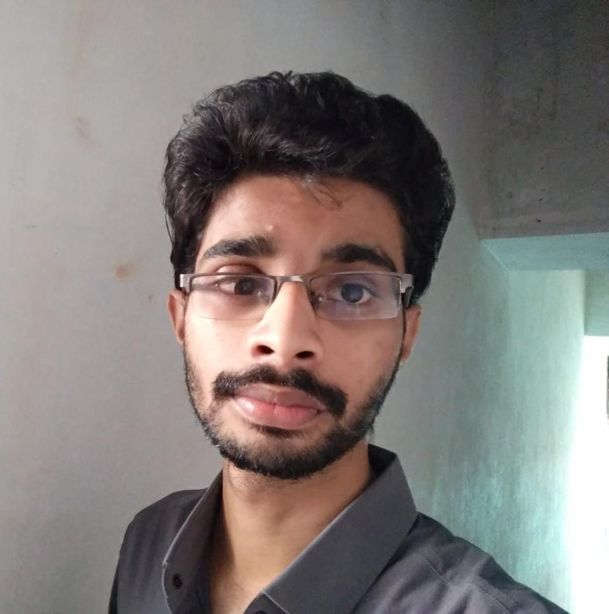



Bandaru Veera Chandra Sekhar
Analyst/Software Engineer
Bachelor of Technology
Electrical and Electronics Engineering: 2018-2022
Bangalore
Skills
chandrasekharcs254@gmail.com
Java 8 /J2EE | Java Basics, OOPS, Generics, Collections, Arrays, Loops, Lambda Exp, Stream API Junit, Mockito, Servlets
Spring core | IOC & Dependency Injection, Autowire
Spring REST | REST controllers, Implementation of GET, POST, PUT & DELETE, Bean Validation & Exception Handling, Testing Services, Controller & Repository layer
Spring Data JPA | Implement DAO layer using spring Data repositories, Transaction Management
Spring Boot Microservices | Spring Boot Starters, annotations, Messaging Service, Sync/Async comms, Swagger API documents
Spring Cloud | Eureka, Netflix Ribbon, Feign Client, Netflix Hystrix & Config Server
React | Components, Hooks, Event handling, Redux, Reducers,
Database | MongoDB My SQL
UI Tech | HTML 5 & CSS 3,JavaScript, ES6 & TypeScript Reusable templates, Optimized UI Designed
Tools | Git, Postman, Maven, IDE
Add On skills | Communications, Team management. Peer learning
+917013927445
A4
Full Stack Developer
Hands on experience in creating microservices with Springboot, Spring Security, Spring Cloud API Gateway, Eureka server..
React developer with working knowledge on ReactJS with react hooks, reactive forms, routing and Material UI.
Experience in creating documentation with Java docs and swagger and in unit testing using Junit, Mockito.
Development experience using Eclipse, intellij, VS Code, pgAdmin for postgreas, postman Api connection and MangoDB by Atlas.
Online Flight Booking System Application
Completed end to end case study of Flight Booking System along with JWT authentication, Swagger and payment, responsive UI with React JS.
Concert Booking System Application
Developed backend applications using Monolithic Architecture and implemented all the CRUD operations using Spring Boot, Postgres, Postman and ReactJs for UI.
Check out my work on GitHub & Video Profile

